Slide 1

CPSC 481 Group 21

Slide 2
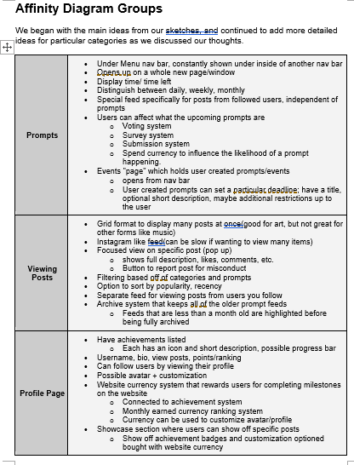
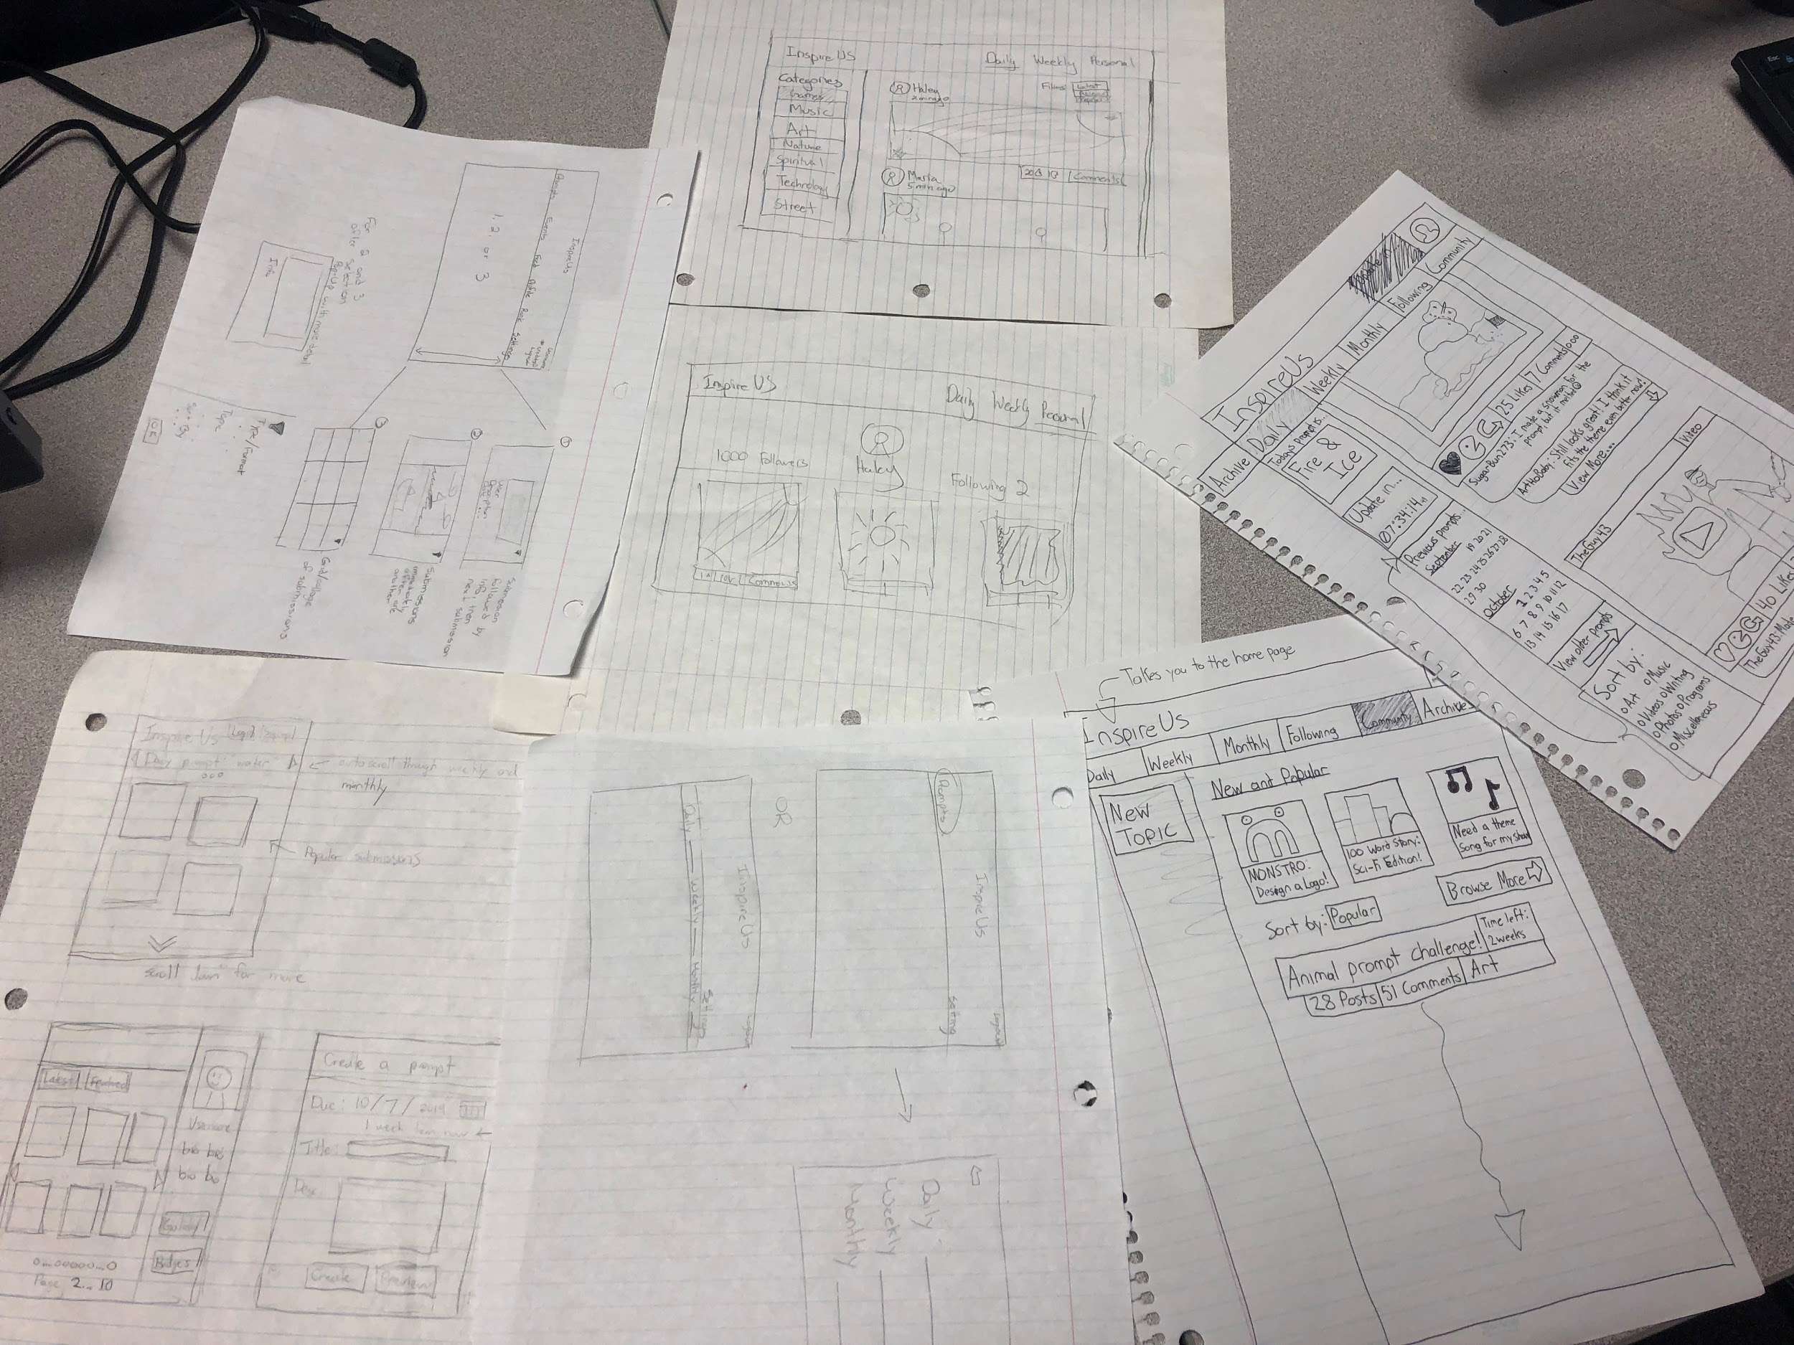
Sketches and Brainstorming
Photo of our interface sketches
Affinity diagram table summary

Slide 3
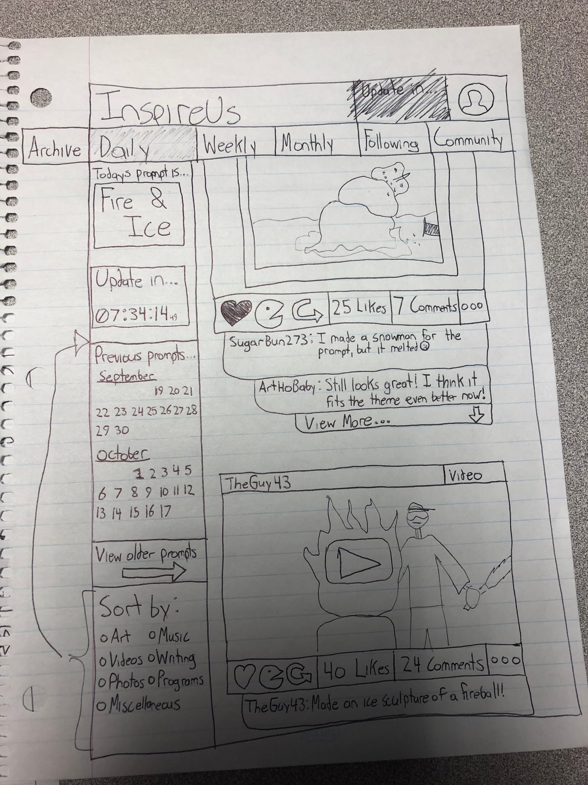
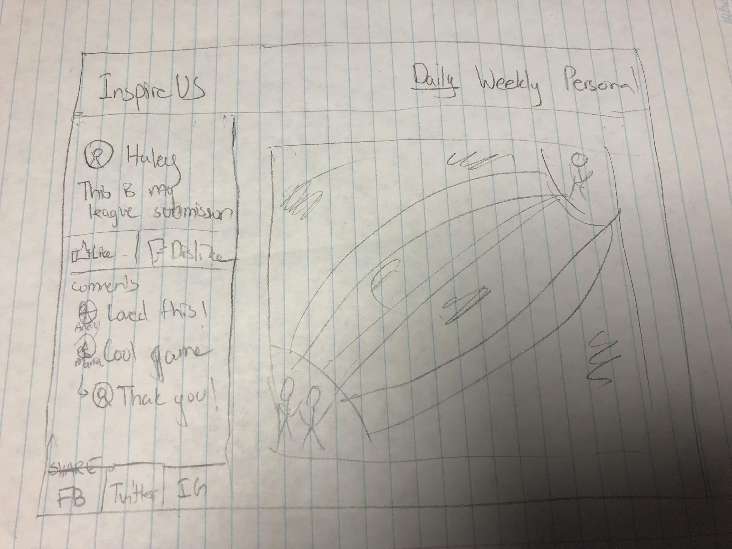
Detailed Sketches
Home screen
Full Post View

Slide 4
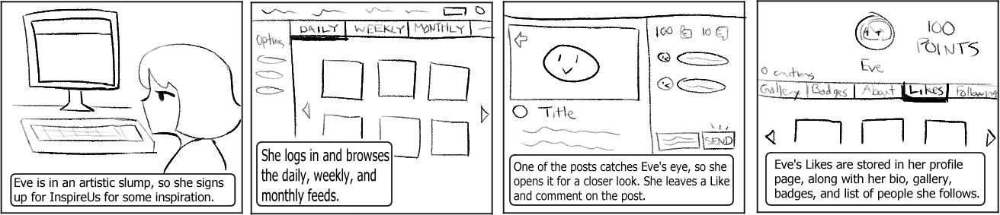
Storyboard
Eve is a new InspireUs user. While logged into her account, she browses the homepage for submissions for the current prompts. Each post can be opened for a closer view, showing its description and comments. Eve Likes one of the posts and leaves a comment. Likes can be revisited under the user profile.

Slide 5
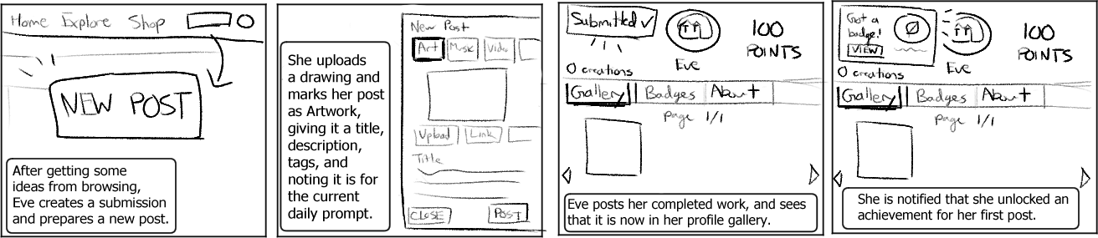
Storyboard
After getting some inspiration, Eve draws something for the current daily prompt. She uploads her artwork, giving it a title, description, and tags it for the correct theme. After submitting the post, it appears in Eve’s profile gallery. There is a notification that Eve has just earned a Badge.

Slide 6
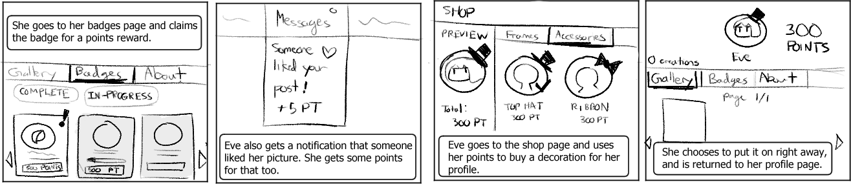
Storyboard
Eve’s Badges are accessible from her profile as well. She redeems her new Badge to receive points, which are the InspireUs currency. Points can also be earned from receiving Likes from other users; these appear in Eve’s messages as notifications. Eve exchanges her points at the Shop for profile decorations. After buying the ‘top hat’ accessory for her profile picture, Eve equips it.

Slide 7
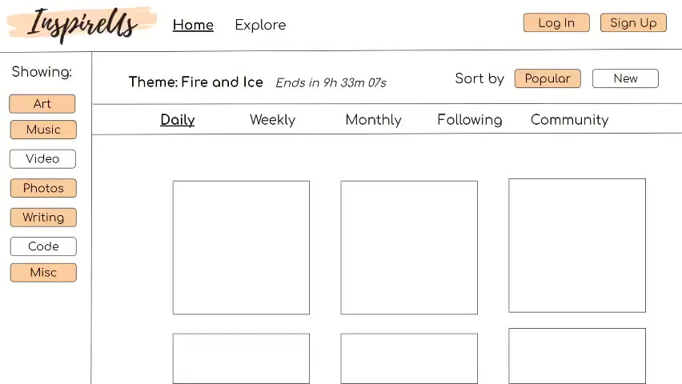
Video Prototype
Our prototype shows the tasks in our storyboard. A user logs in and browses the homepage, liking and commenting on a specific post. They submit an art post and receive a badge, which is redeemed for points. Afterward, they buy a new accessory from the shop and put it on.

Slide 8
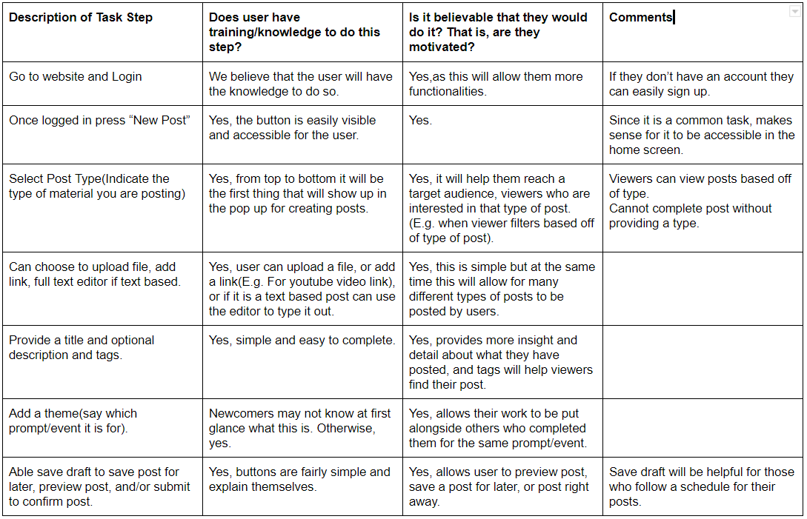
Task-Centered Walkthrough - Create Post
In general, our tasks were straight forward
Quick post creator could be improved to allow image cropping and changing layout with multiple files
Could add example tags

Slide 9
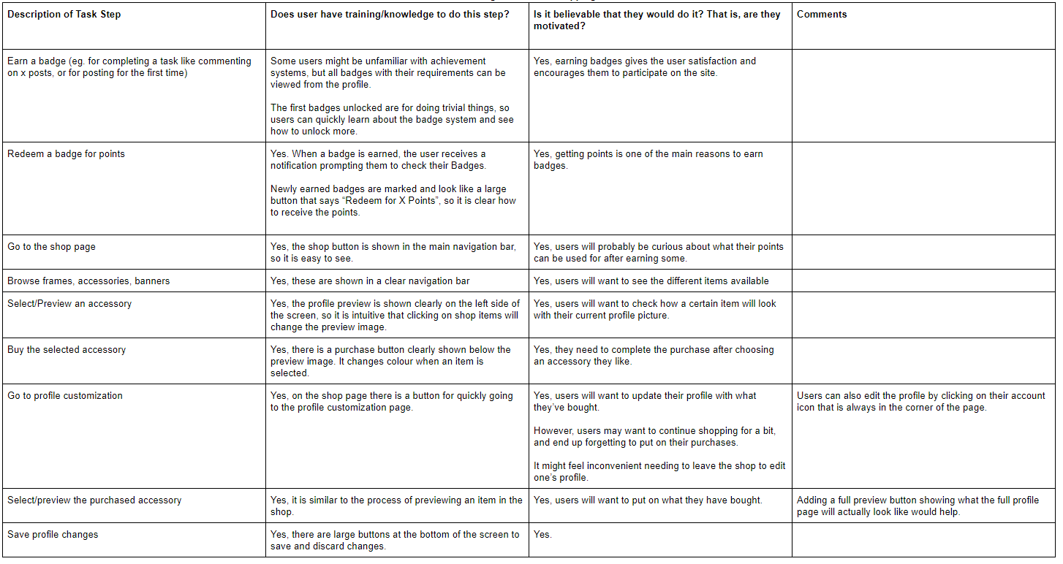
Task-Centered Walkthrough - Earn Points+Shop
Need to go to separate screen to put on new purchases
User can only buy 1 item at a time
An option to fully preview the profile would be useful

Slide 10
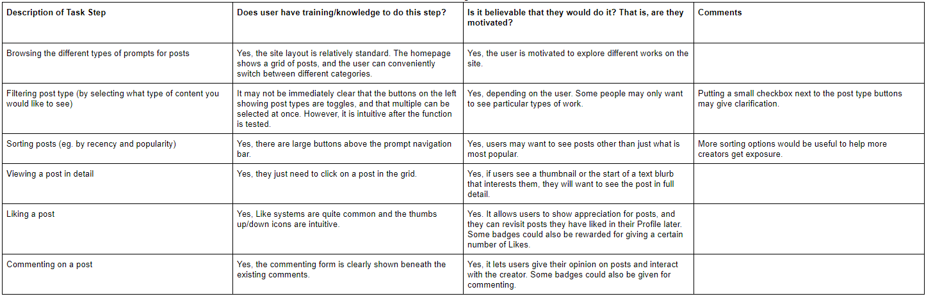
Task-Centered Walkthrough - Browsing Posts
Filter buttons not obvious as toggles
More sorting options to improve creator exposure

Slide 11
Reflection
Sketches allowed us to develop a variety of ideas
Difficult to narrow down which features would be best, hard to decide between layouts (grid vs. scroll)
Determining which tasks to focus on was tricky due to changes since Stage 2; revising task descriptions early would have helped
Online collaboration was improved by forming task lists
Maintaining consistent design when integrating was challenging

